Slide 1

ESP32-CAM AI Follow-Me Robot
Wireless Control • Obstacle Avoidance • Web Interface
CMP3010 – Embedded Systems Programming Project
Bahçeşehir University | Spring 2025
Presentation Date: May 23, 2025

Slide 2
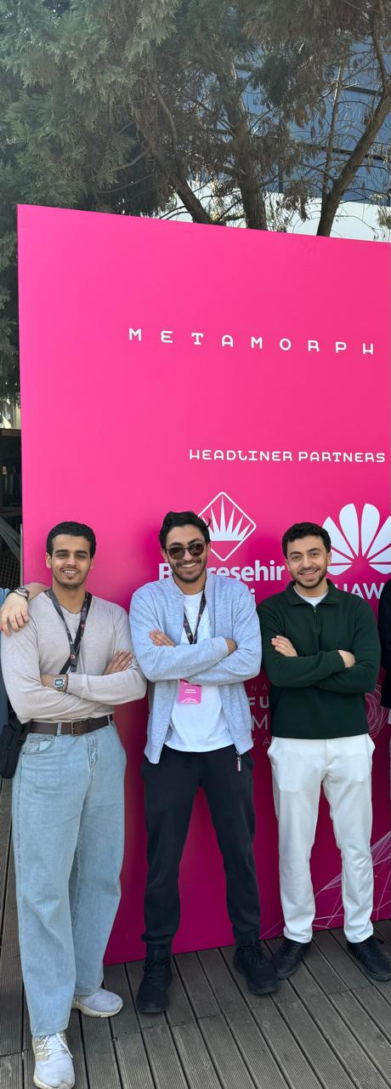
Team Introduction
Abdullah Al-Shobaki
Mohamed Alkozendar
2284612 – AI & Arduino Dev
2283149 – Computer Vision &
Web UI Dev
Mohammed Al-labani
2105990 – Hardware Integration & Testing

Slide 3
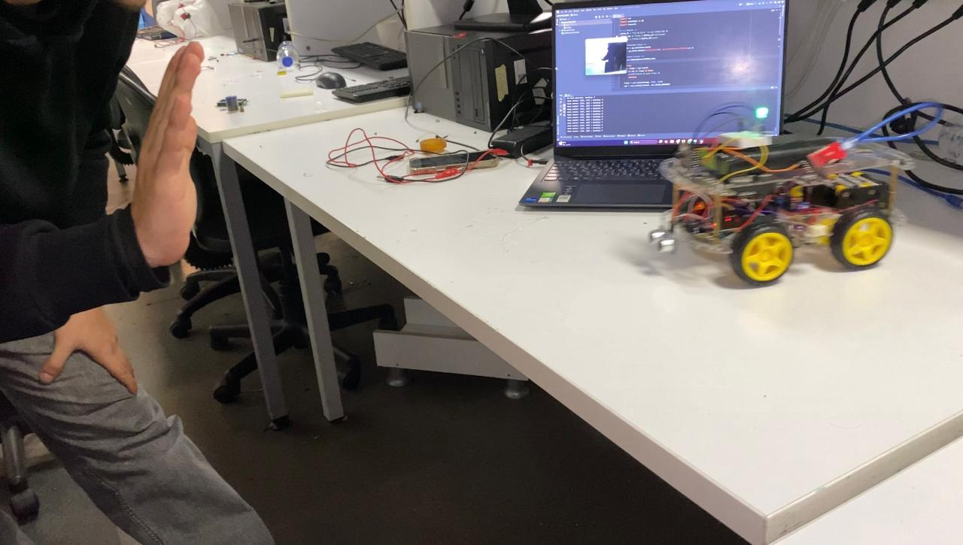

Project Overview
Project Goal
Key Features
Design and build an AI-powered robot that can track and follow a user using real-time computer vision.
Follow-Me Mode – Tracks and follows a user’s hand in real-time using computer vision.
Random Personality Mode – Activates after 30 seconds of no hand detection until finding the user
Obstacle Avoidance – Uses ultrasonic sensor to detect and avoid objects.
Wifi Operated Iterface– Built a wireless Robot control interface
RGB LED Feedback – Indicates tracking (green) or idle state (red)
Core Technologies
ESP32-CAM, Arduino Mega, Python,
MediaPipe, OpenCV, Gradio, L298N Motor
Driver, HC-SR04 Sensor

Slide 4
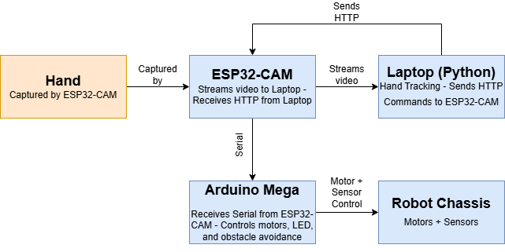

System Architecture
ESP32-CAM
Captures video stream and receives HTTP commands from the laptop
Drives the four DC motors based on
commands from Arduino Mega
Motor Driver (L298N)
Ultrasonic Sensor (HC-SR04)
Detects obstacles and prevents collisions by interrupting movement
Enables mobility and supports all
mounted components
Wheels & Chassis
12V battery for motors, 6V battery for Arduino Mega, power bank for ESP32-CAM
Power Supply

Slide 5
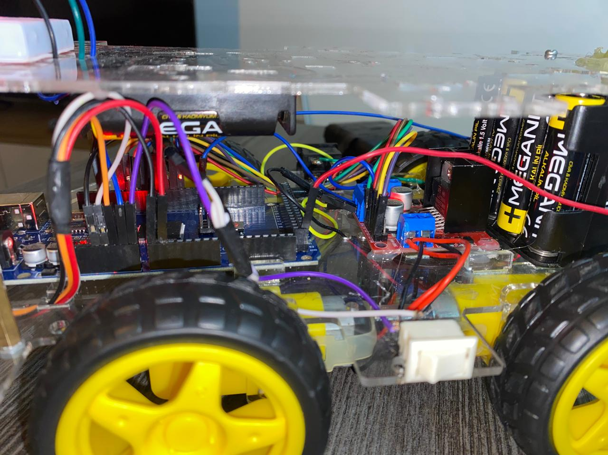
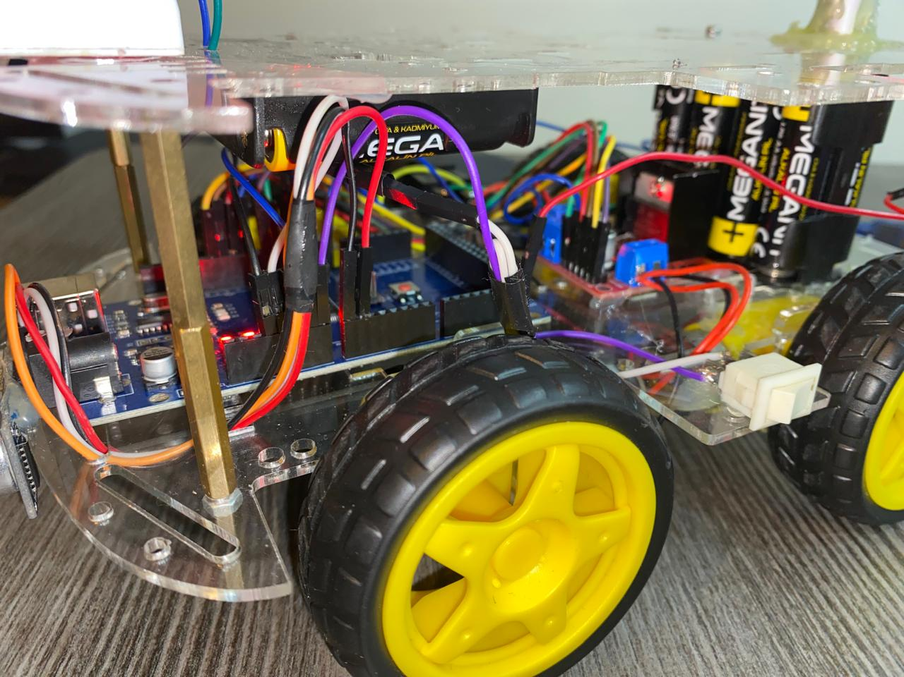
Electrical Wiring Schematic
• Arduino Mega handles all component connections directly
• L298N motor driver wired to 4 DC motors and Arduino digital pins
• HC-SR04 ultrasonic sensor connected to Arduino (Trig/Echo pins)
• RGB LED connected to PWM pins for status feedback
• ESP32-CAM powered via USB and sends serial commands to Arduino Mega
• Powered using 12V motor battery + power bank for logic
• Two switches used for safe power isolation

Slide 6
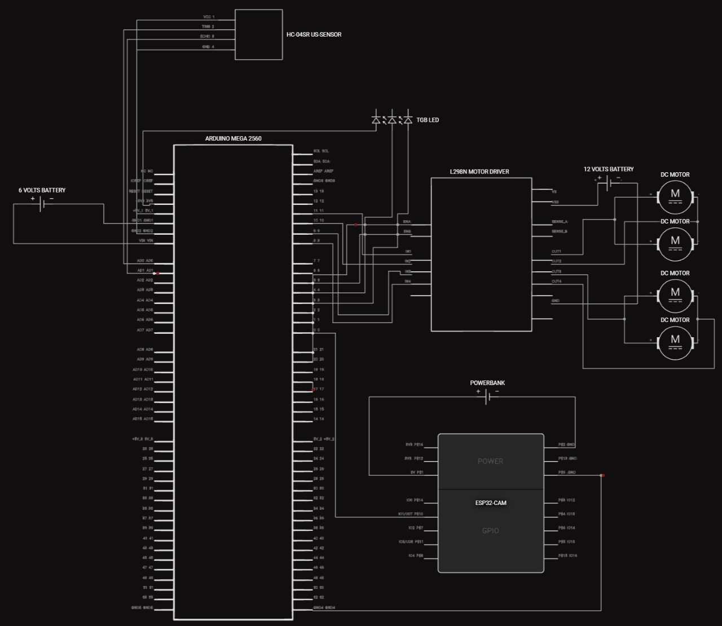

Slide 7
Computer Vision: Real-Time Hand Tracking
Image Processing
Detection Method
Decision Logic
System Response
Real-time video stream from ESP32-CAM, fetched and processed using OpenCV in Python
Hand tracking using MediaPipe Hands model (21 landmark points, palm detection)
Based on X-position of hand landmarks: move left, right, forward, or stop
Laptop sends HTTP command to ESP32-CAM → ESP32 relays serial command to Arduino instantly

Slide 8



Obstacle Avoidance System
Detection Logic
2
If an object is detected closer than 20 cm, the robot immediately stops and performs a 90° turn (usually right) to avoid collision.
Sensor
HC-SR04 Ultrasonic Sensor
Continuously measures distance between the robot and any object ahead.
1
Behavior Override
3
Obstacle avoidance logic overrides any hand-tracking or manual commands for safety.

Slide 9
Wireless Control: Gradio Web Interface
ESP32-CAM Interface
Control Commands
Communication Protocol
Technology Stack
Receives HTTP GET requests from the laptop on /move?dir=X, relays via serial to Arduino Mega.
Forward, Backward, Left,
Right, Stop
Sent based on hand
tracking or button click on
UI.
Developed in Python using Gradio and Requests — no HTML or JavaScript required, making it fast and minimal.
HTTP on port 80, with communication over a shared Wi-Fi hotspot.

Slide 10
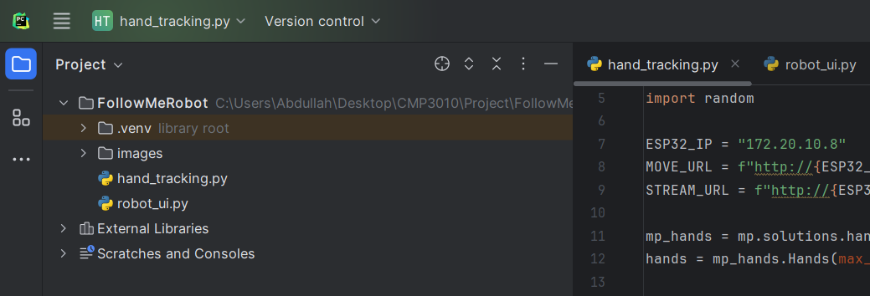

Software Implementation
1
Languages & IDE
Arduino (C++) – For controlling motors, ultrasonic sensor, and LED
Python – For hand tracking, UI, and communication logic
IDEs used: Arduino IDE and PyCharm
2
Libraries Used
MediaPipe – Hand tracking
OpenCV – Stream processing
Gradio – Web UI interface
Requests – for HTTP communication
Arduino – NewPing, Serial, basic I/O
3
Code Structure
hand_tracking.py - Detects hand & sends commands
robot_ui.py - Gradio UI and manual control
Arduino code – Listens to serial, handles movement commands and obstacle avoidance
4
Repository
GitHub Repository: esp32-ai-follow-me-robot

Slide 11
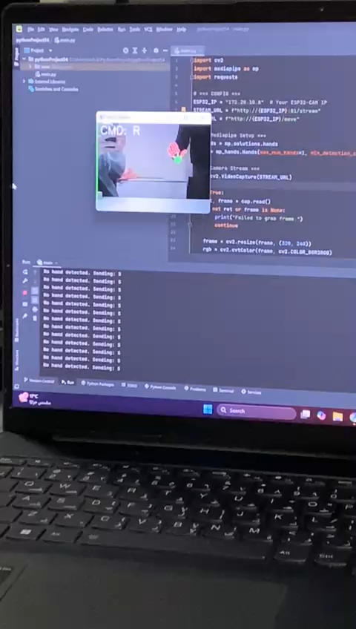
Results and Demonstration
Following Speed
~0.5 m/s (based on hand tracking accuracy)
Obstacle Avoidance
100% stop accuracy within 20 cm range
Wireless Control Delay
~80–100 ms (Gradio → ESP32 → Arduino)
Up to 2 hours continuous tracking operation (Tested under normal tracking conditions)
Battery Life
Demo: Real-time hand tracking and robot response speed

Slide 12

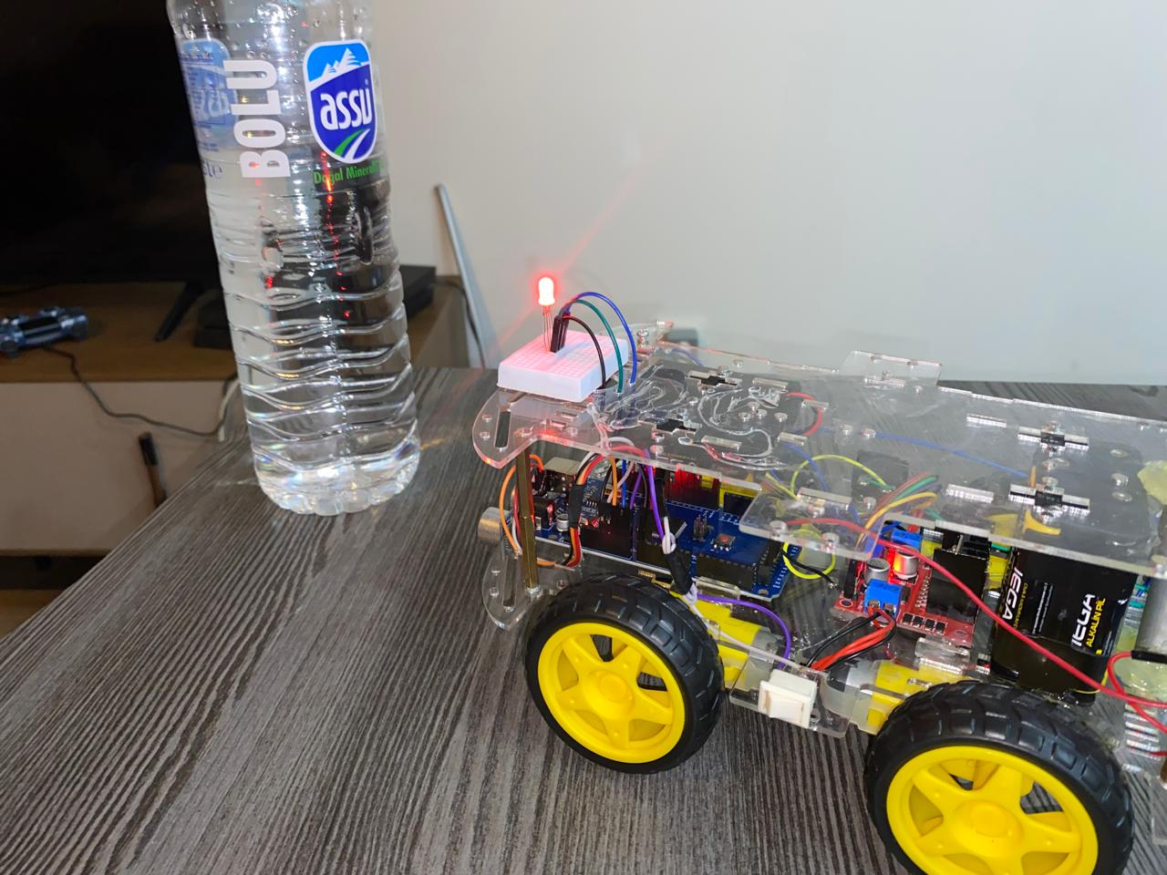
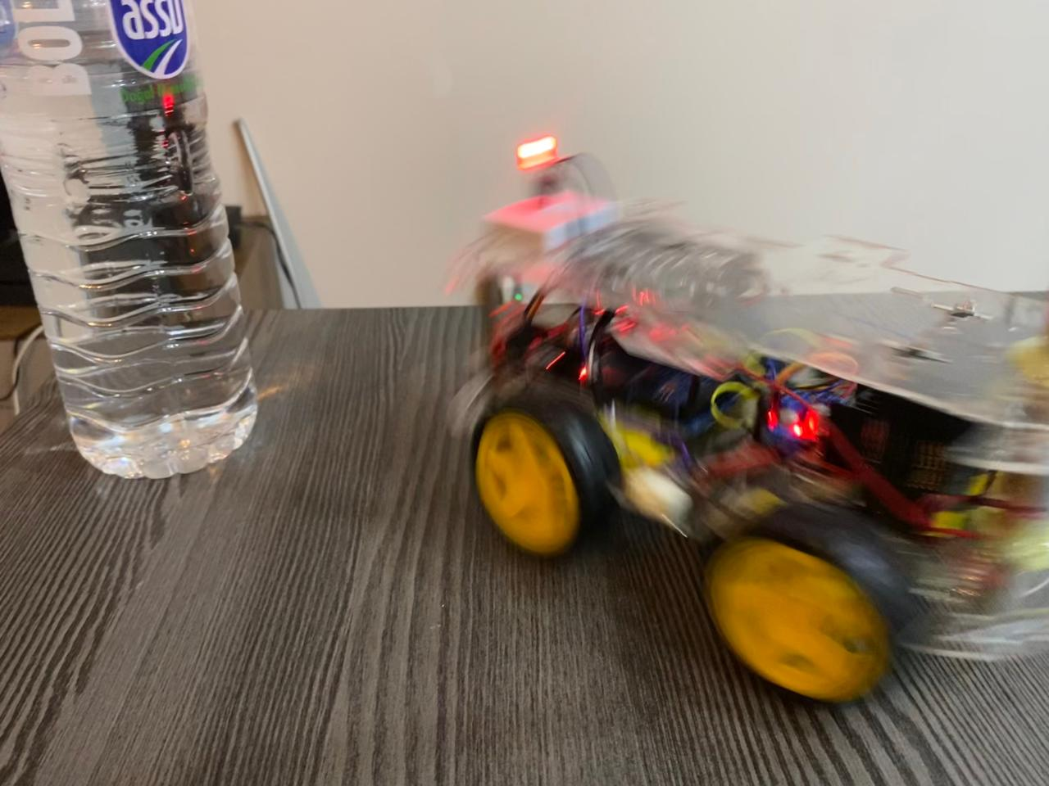
Demo Highlights
Real-Time Hand Tracking
The robot uses real-time hand tracking (MediaPipe) to follow a user's hand. Smooth directional control is
triggered based on hand position (left, center, right).
Approaching Obstacle
As the robot approaches a nearby object, the ultrasonic sensor detects it within 20 cm and prepares to
stop or reroute.
Active Obstacle Avoidance
Upon detection, the robot stops and performs a 90° turn to avoid the object, maintaining safe and
autonomous navigation.
Live demo showcased real-time AI — combining vision, sensing, and motion control with accuracy and autonomy.

Slide 13
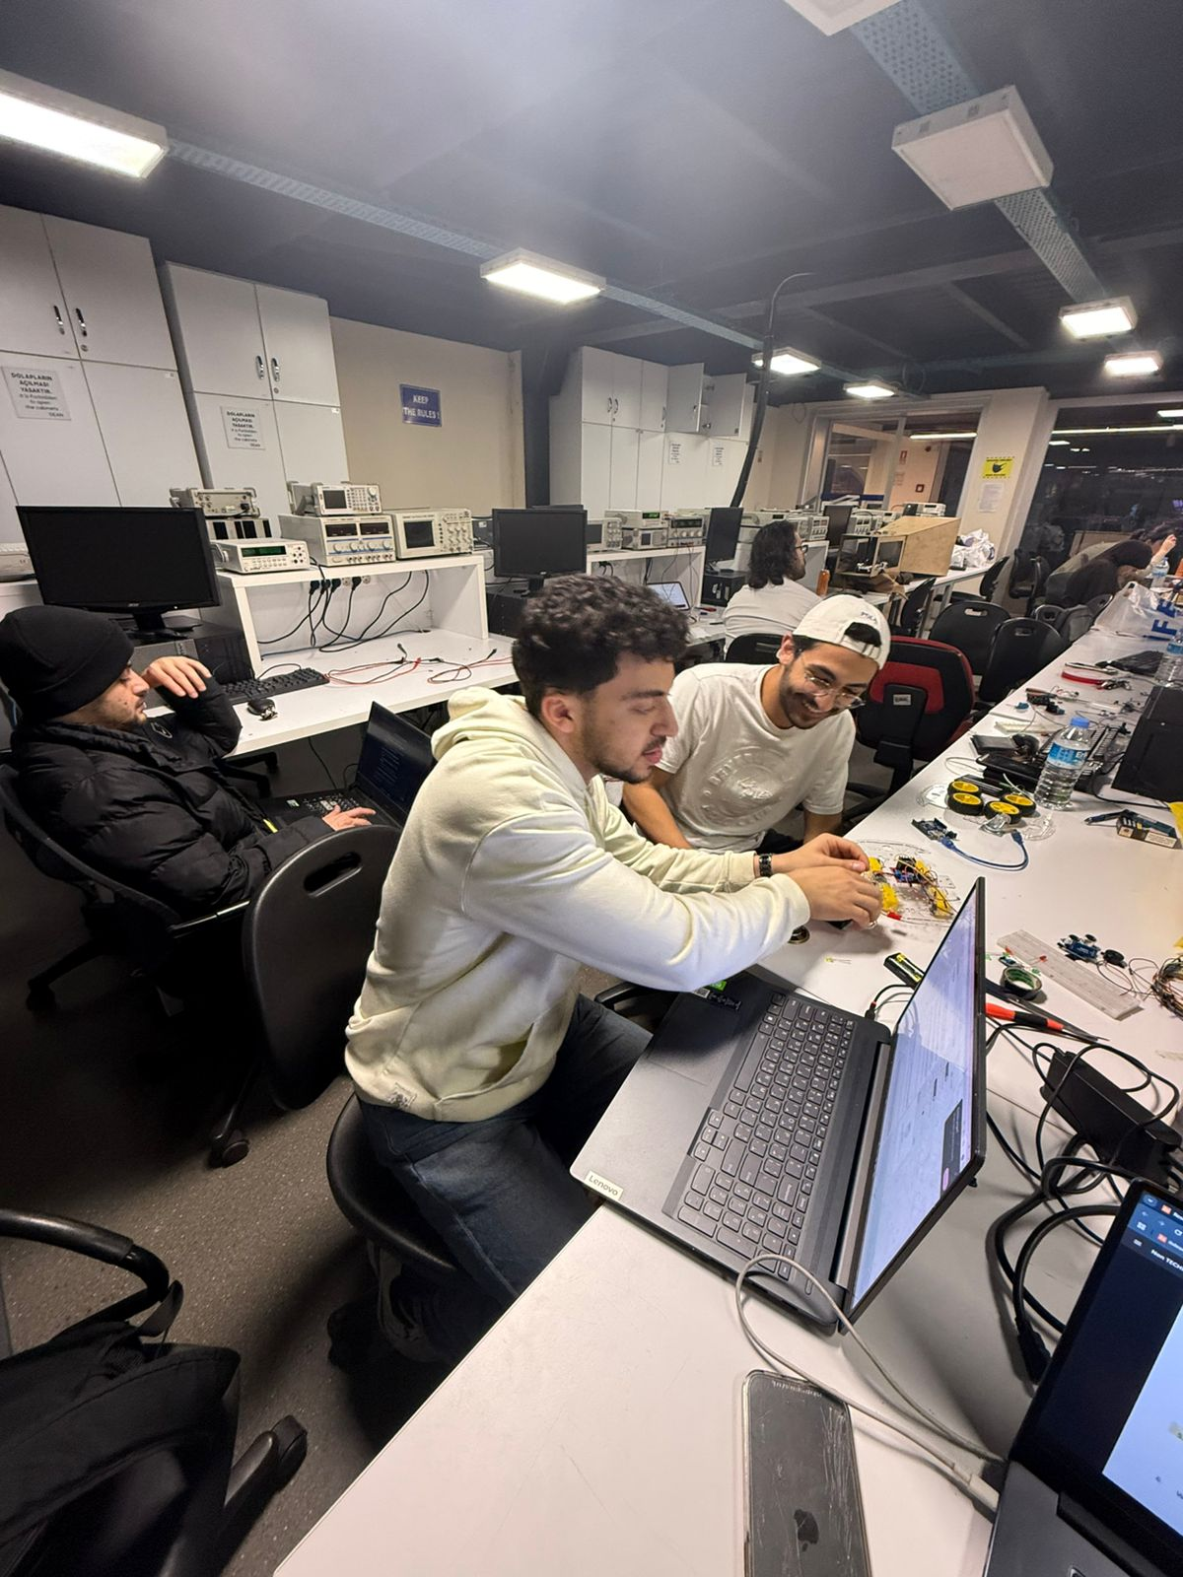
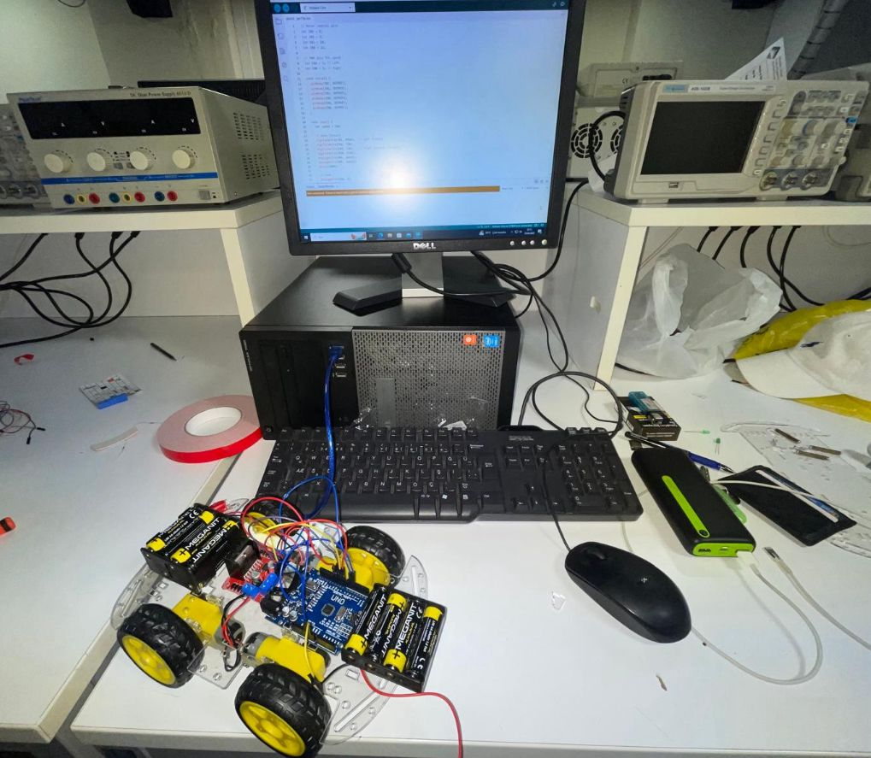
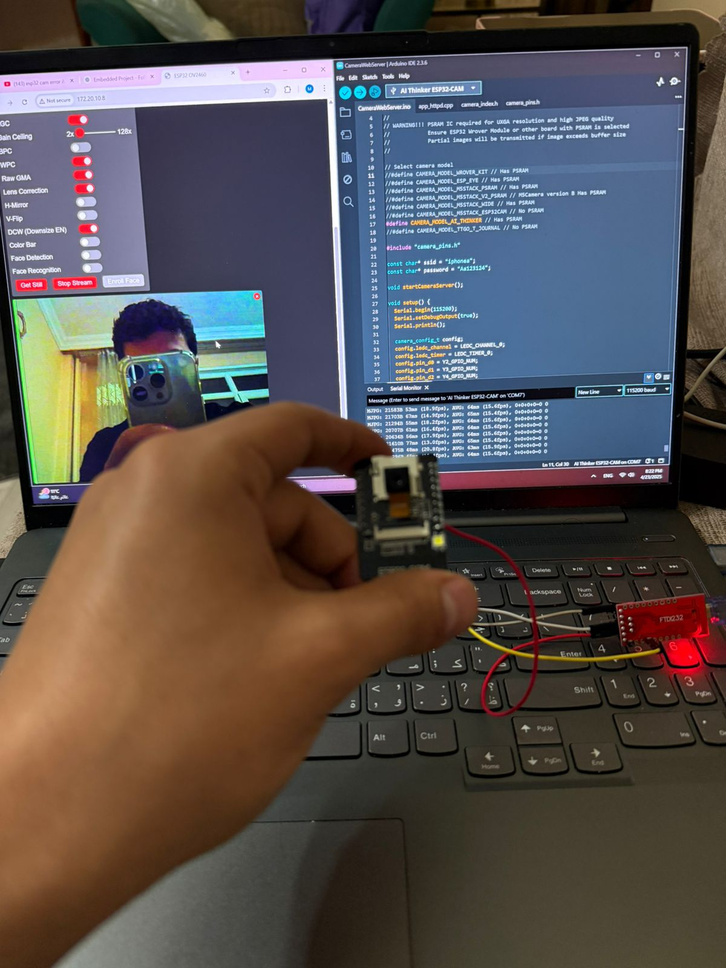
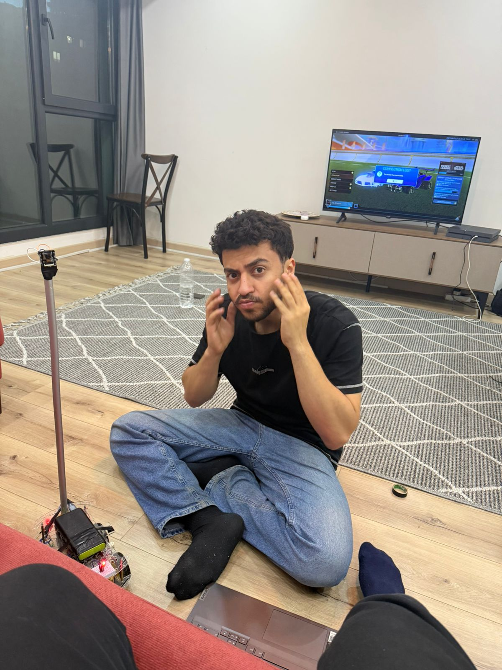
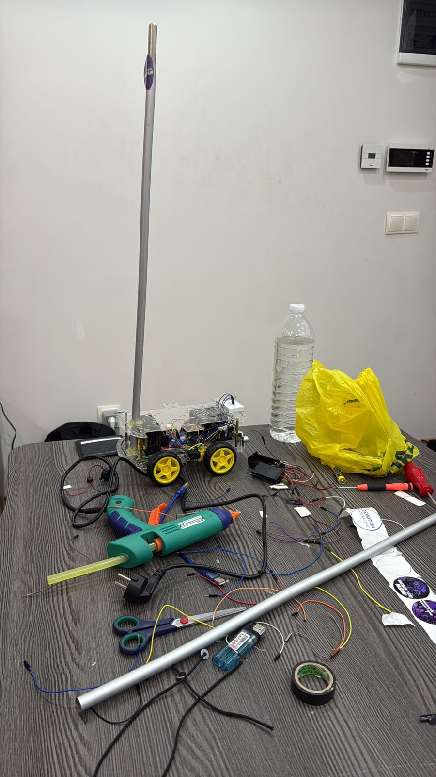
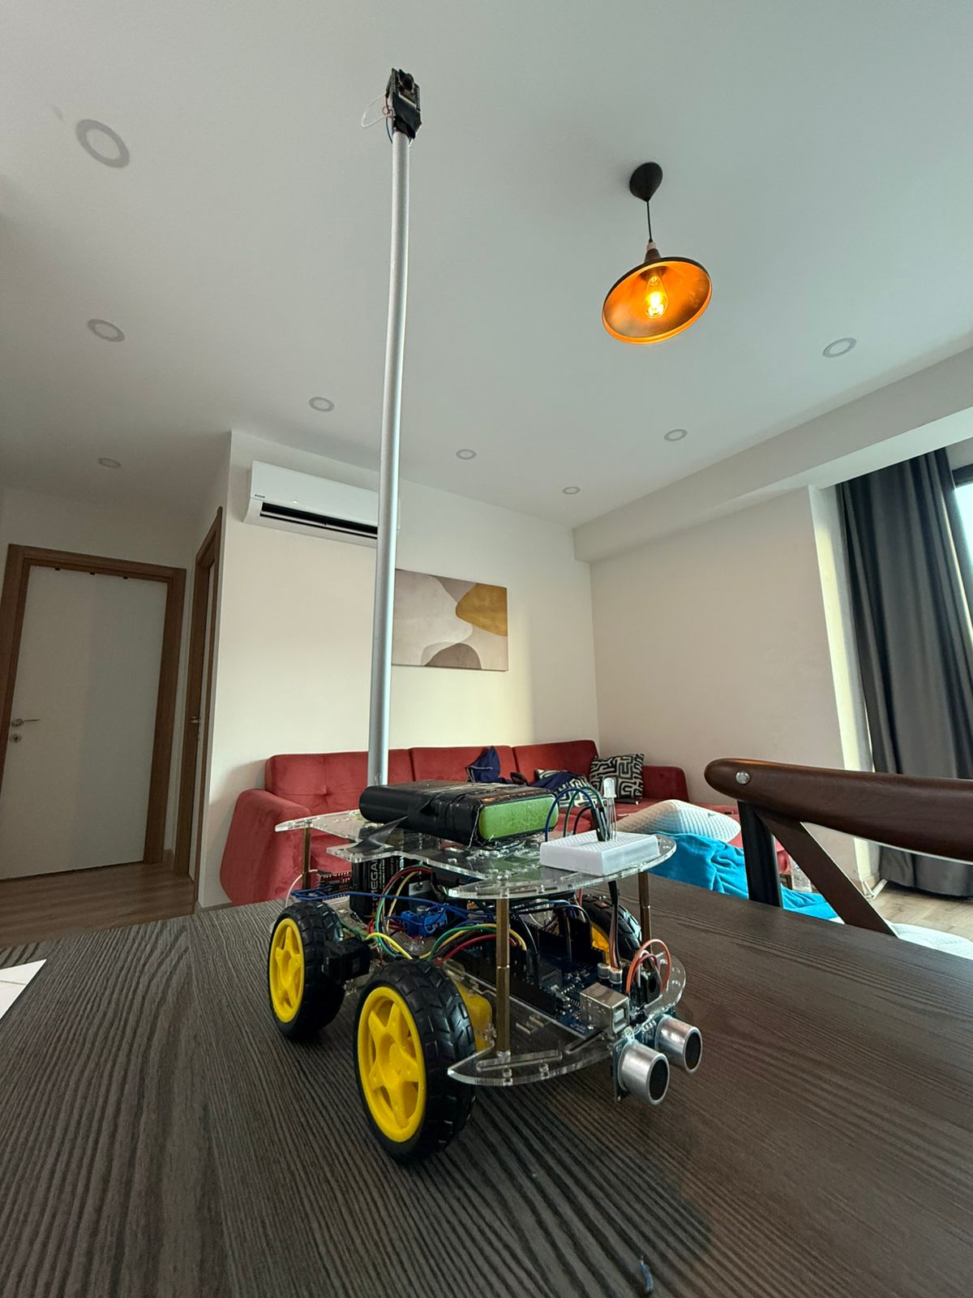

Our Development Journey
Early Construction Phase
First working demo
Setting up the Camera
Full Demo Trial
Last Arrangements
The Final Boss

Slide 14

Conclusion and Future Work
Project Achievements
Built a functional AI-powered robot that:
• Tracks and follows a user via hand gestures
• Avoids obstacles in real time
• Supports manual and autonomous modes
• Includes interactive behavior like random mode
• Uses a web interface for control & demo
Future Enhancements
Upgrade to a Jetson Nano or Pi Zero 2 W for onboard AI processing
Integrate SLAM to allow intelligent navigation and mapping
Expand to gesture-based command recognition (e.g., stop, turn)
Add mobile control app (Gradio → Android/iOS front end)
Battery monitoring + LED indicators for health + mode status

Slide 15
References
MediaPipe: Used for real-time hand tracking with landmark detection
OpenCV: Used for frame capture, image preprocessing, and stream handling
Gradio: Framework used to build the custom web control interface
ESP32-CAM Documentation: Hardware setup and serial communication reference
ChatGPT-4o (OpenAI): Assisted with hardware planning, debugging, and full project documentation
Prof. Mahmut Ağan: Project supervisor, CMP3010 – Bahçeşehir University
Fahd Al-Sattaf: Provided hands-on support with hardware wiring, testing, and debugging

Slide 16
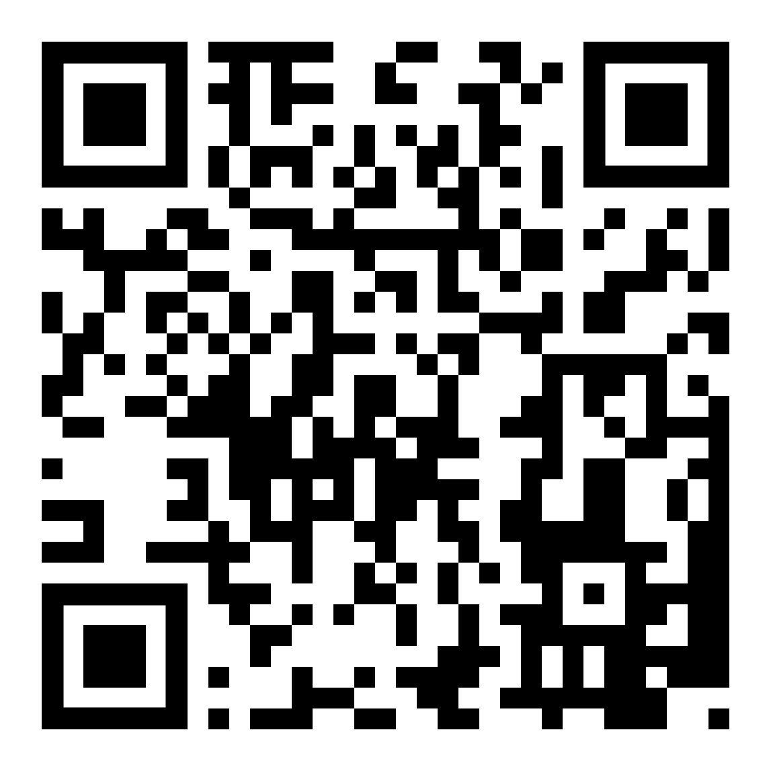
Thank You
We appreciate your time and attention.
Hope you enjoyed our presentation!
GitHub Repository: github.com/3bdulah/esp32-ai-follow-me-robot
Scan the QR code to explore the full project

